Slide 1
Project #2: Energy Storage Devices Based on Three Dimensional (3D) Graphene:
Lithium- Sulfur (Li-S) Batteries
FM/AC: Dr. Vesselin Shanov
Sub AC: Dr. Noe Alvarez
GRA: Yu-Yun Hsieh
RET Teachers: Tiara Anderson, Purcell Marian High School
& Michael Sullivan, Princeton High School
Grant ID No.: EC-1404766

Slide 2
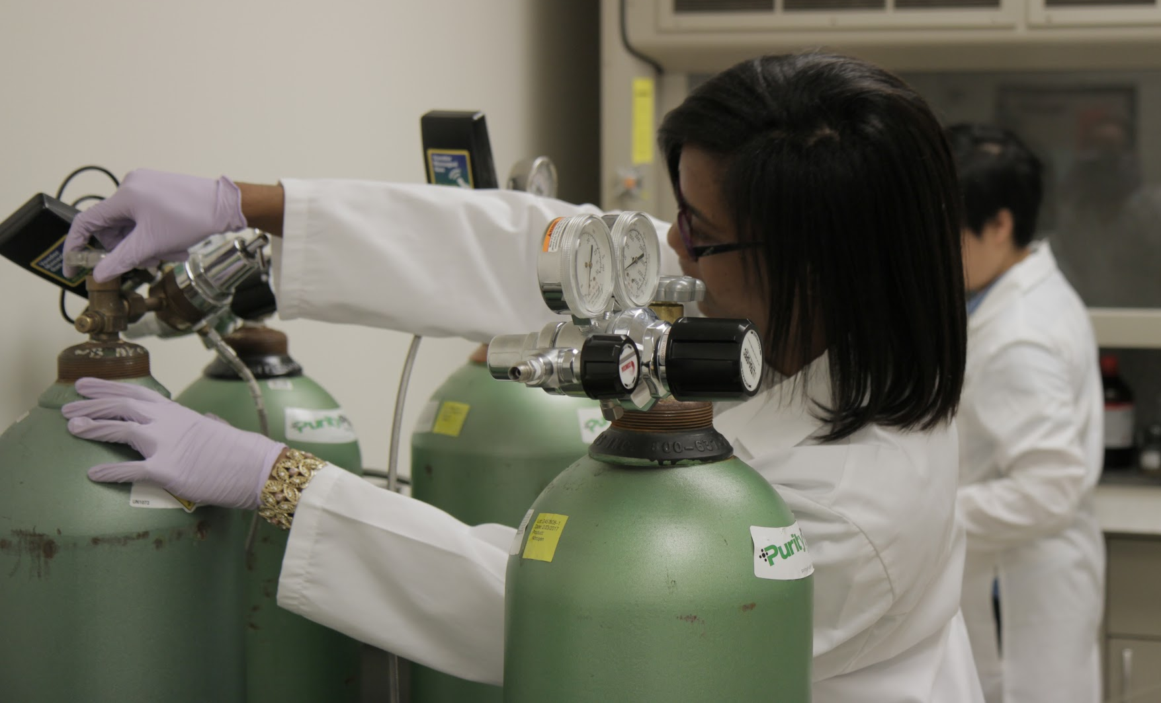
Table of Contents
Abstract
Literature Review
Objectives
Research
Procedures
Training
Results
Research Conclusions
Unit plans
Li-S Batteries

Slide 3
Abstract
Wind, water, solar → need better batteries
Li-S = 5x energy density of current batteries
Chief technical obstacle:
polysulfide shuttling reducing cyclability
Proposed solution:
laser milled 3D graphene
1
Li-S Batteries

Slide 4
Abstract
Wind, water, solar → need better batteries
Li-S = 5x energy density of current batteries
Chief technical obstacle:
polysulfide shuttling reduces cyclability
Proposed solution:
laser milled 3D graphene
2
Li-S Batteries

Slide 5
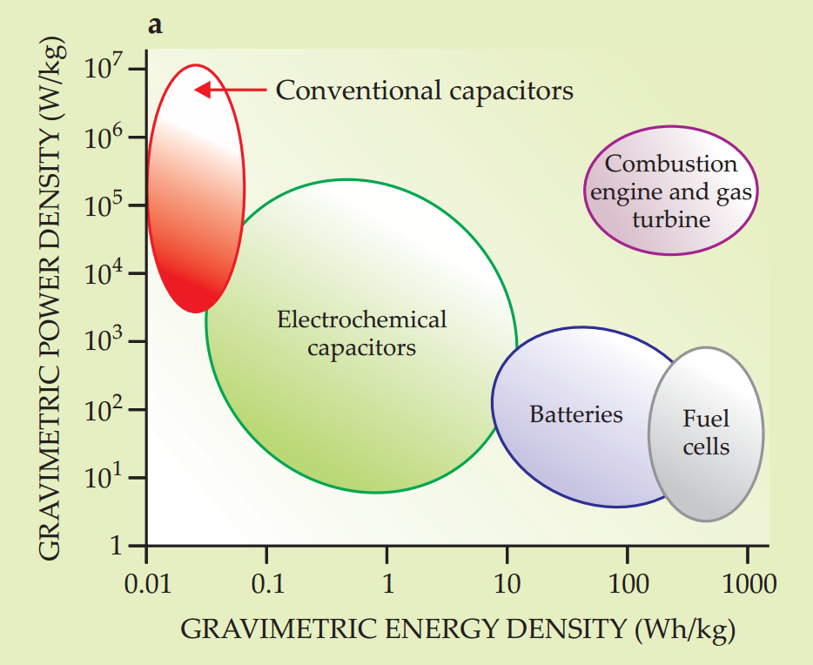
Introduction
Literature Review
We need energy storage that performs like fossil fuels
3
Abruña, H. D., Yassuyuki, K., Henderson, J. C. (2008). “Batteries and electrochemical capacitors.” Physics Today, December, 2008.
Notes:
Ragone Plot

Slide 6
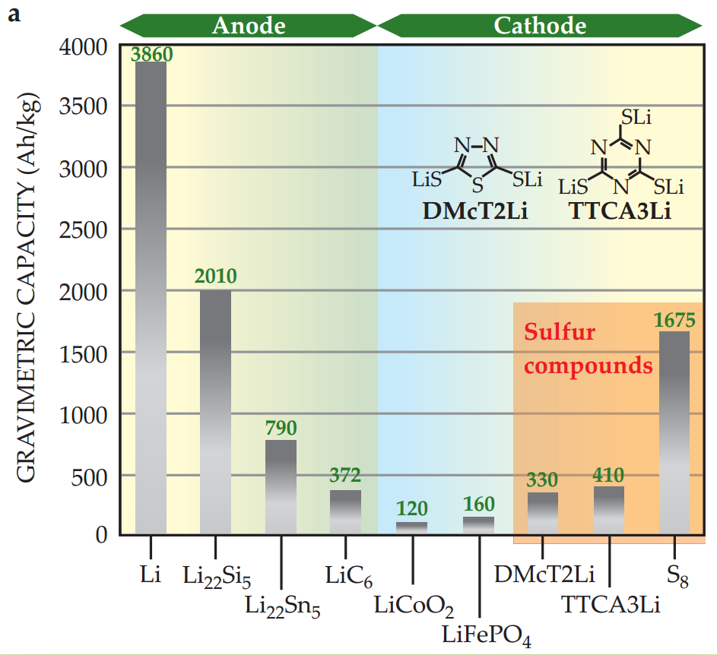
Lithium sulfur:
an obvious choice
Literature Review
4
Abruña, H. D., Yassuyuki, K., Henderson, J. C. (2008). “Batteries and electrochemical capacitors.” Physics Today, December, 2008.
Notes:
Lithium has the highest electrochemical potential and the largest specific energy per weight. Low cost, high abundance of sulfur, low toxicity

Slide 7
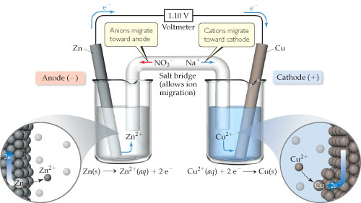
Redox Reaction
Literature Review
5
http://session.masteringchemistry.com/problemAsset/1352502/3/Figure_P20.5.jpg
Notes:
REDOX Reaction
Reduction at the cathode-- receives the electrons (Cathode) is the positive electrode
Oxidation at the anode -- produces electrons (Anode) is the negative electrode
Salt Bridge contains electrolyte -- keeps neutrality but must not interfere with the chemical reactions occurring
Zinc - anode Copper -- cathode
Salt bridge (electrolyte) - keeps the reaction going

Slide 8
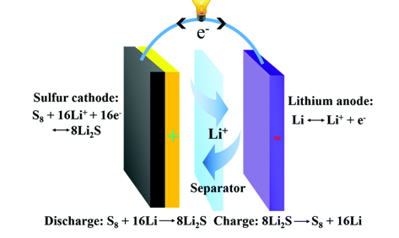
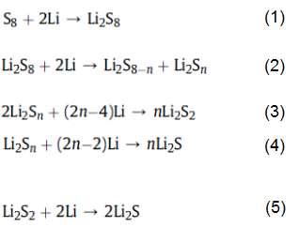
Redox Chemistry of Li-S Battery
Literature Review
6
Chem. Soc. Rev. 2016, 45, 5605.

Slide 9
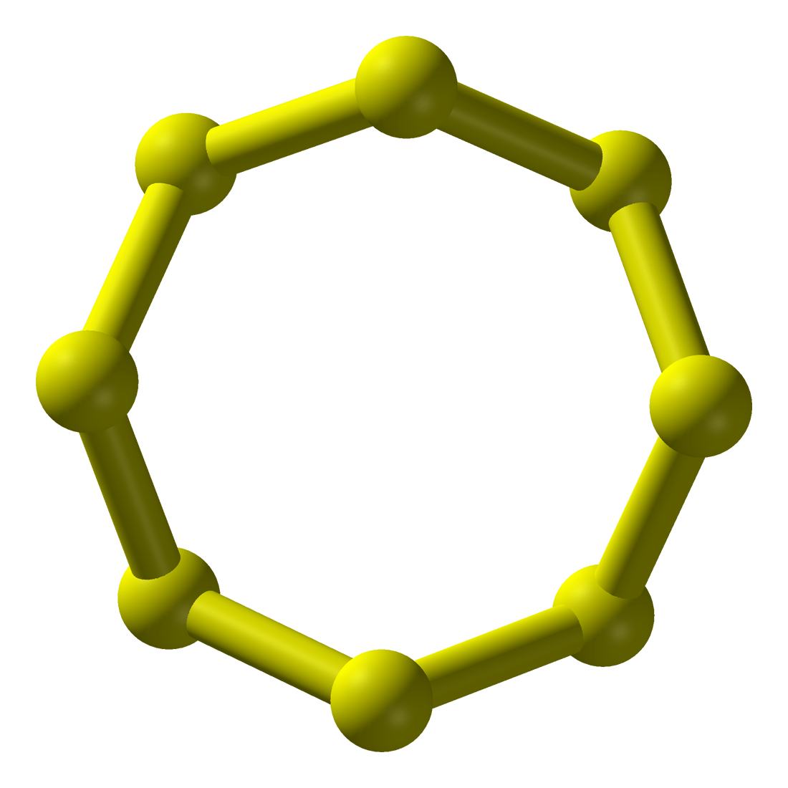
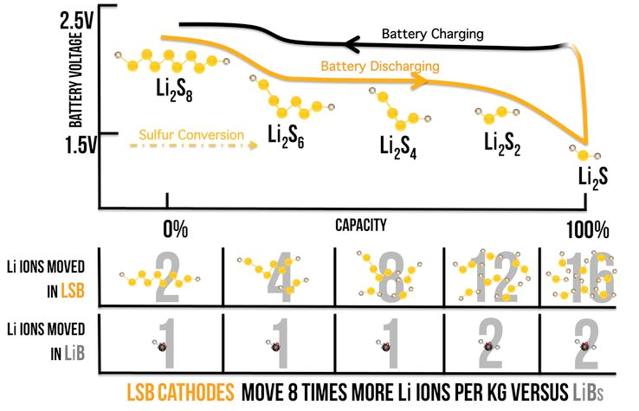
The Li-S advantage over Li-ion
Literature Review
7
EndLiS Energy (2017), “Advanced Sulfur Cathodes.” EndLiS Energy, http://www.endlisenergy.com/our-technology.html
Notes:
Sulfur accepts two lithium ions

Slide 10
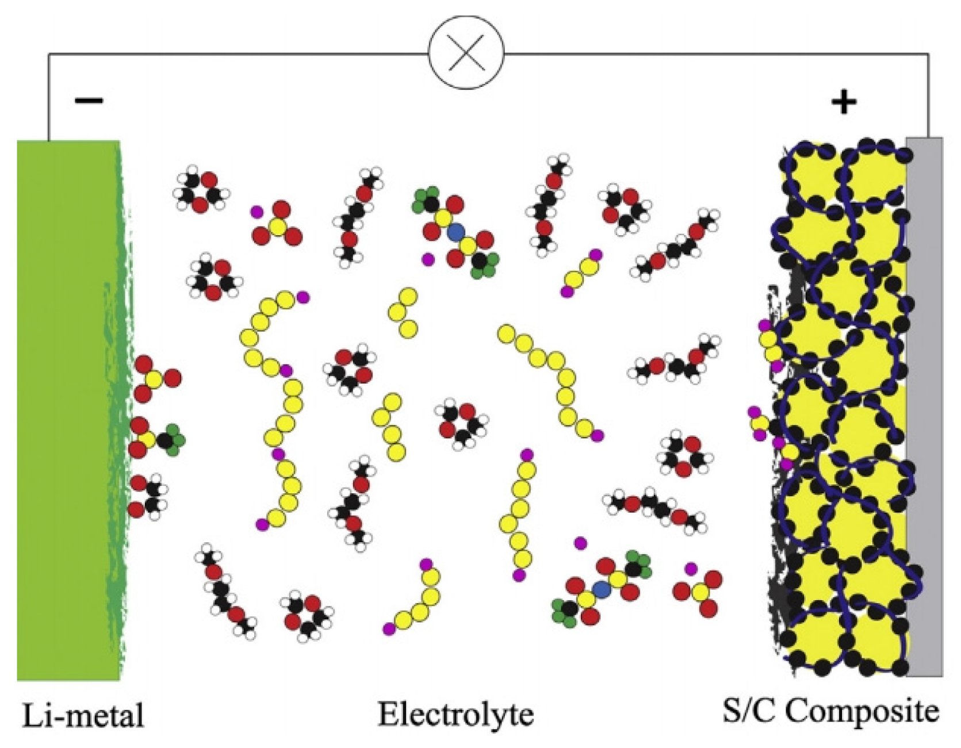
Sulfur Cathode Challenge #1:
S₈= 2 g/cm³
Li₂S = 1.66 g/cm³
Literature Review
8
Gu, X., Hencz, L., Zhang, S., (2016). Recent Development of Carbonaceous Materials for Lithium–Sulphur Batteries. Batteries 2(4): 33.
Notes:
Anode vs Cathode
I

Slide 11
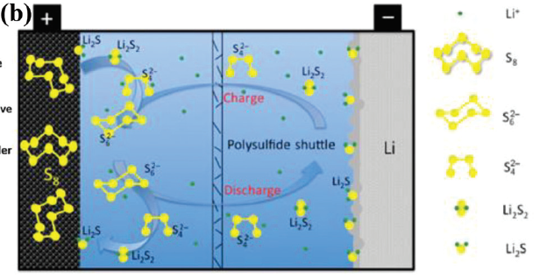
Sulfur Cathode Challenge #2:
Polysulfide Shuttle Effect
(low cyclability)
Literature Review
9
Kang, W., Deng, N., Ju, J., Li, Q., Wu, D., Ma, X., Li, L., Naebe, M., and Cheng, B. (2016). “A review of recent developments in rechargeable lithium–sulfur batteries.” Nanoscale, Royal Society of Chemistry, 8(37), 16541–16588.
Notes:
Polysulfide Shuttling Effect: causes lithium sulfur batteries to have low Coulombic Efficiency ( the charge efficiency by which electrons are transferred in batteries)
Polysulfides are soluble and are able to freely move in electrolyte between anode and cathode. High order polysulfides migrate to the anode react with lithium metal causes reduction in active material

Slide 12
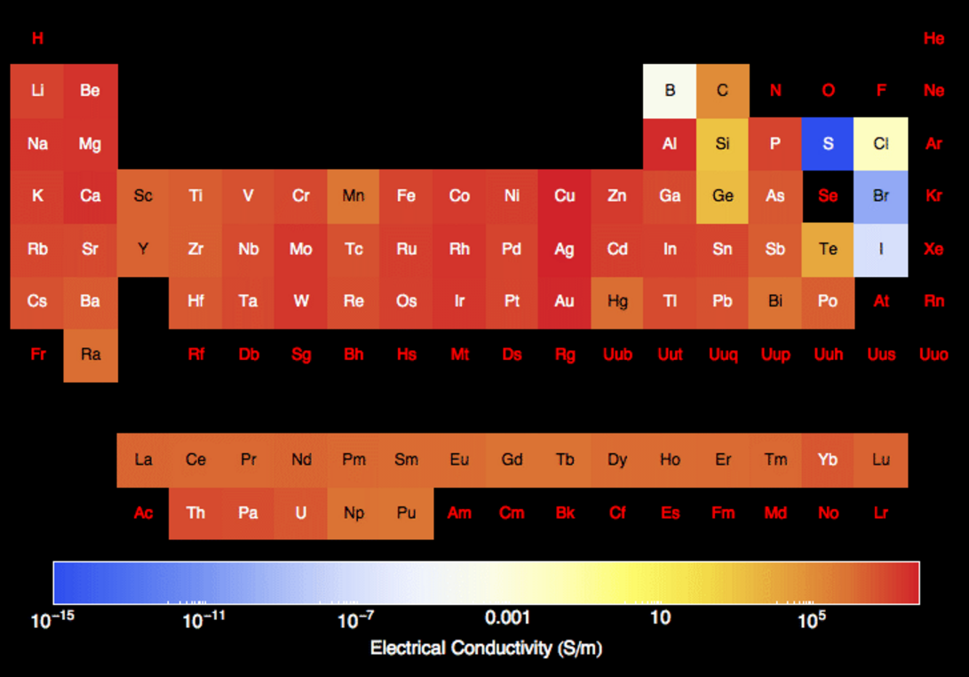
Sulfur Cathode Challenge #3:
Sulfur is a Natural Insulator
Literature Review
10
PeriodicTable.com (2017). “Electrical conductivity of the elements.” http://periodictable.com/Properties/A/ElectricalConductivity.st.log.html [accessed June 27, 2017}.
Notes:
Anode vs Cathode
I

Slide 13
Literature Review
Motivation for Using Synthesized Graphene as Host (Inactive Material)
Sulfur’s Challenges | Graphene’s Solutions
Volume expansion | Highly porous
Polysulfide Shuttling Effect | Mesoporous (pore sizes from 2nm - 50nm)
Insulating | Highly conductive
11
Notes:
Strong mechanical properties to hold sulfur
Structurally sound yet flexible

Slide 14
Objectives
Objectives
Overall Objective:
Build Li-S battery using laser milling to create consistent energy density over many charging cycles
Sub-Objectives:
assemble cathode with 65+% weight sulfur
cycle battery with minimal polysulfide shuttling
12
Notes:
Laser mill first THEN plasma
More area with oxygen functionthat adds carbonyl and hydroxyl groups functional groups to make graphene a more hydrophilic surface and increase the wettability of the surface
Laser milling the surface of the graphene to increase surface area
al groups

Slide 15
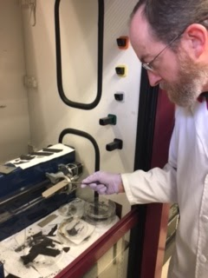
Research Procedures
Research Procedures
Introduce laser milling to sulfur cathode assembly
Assemble coin cell battery using new cathode composite
Test battery
13

Slide 16
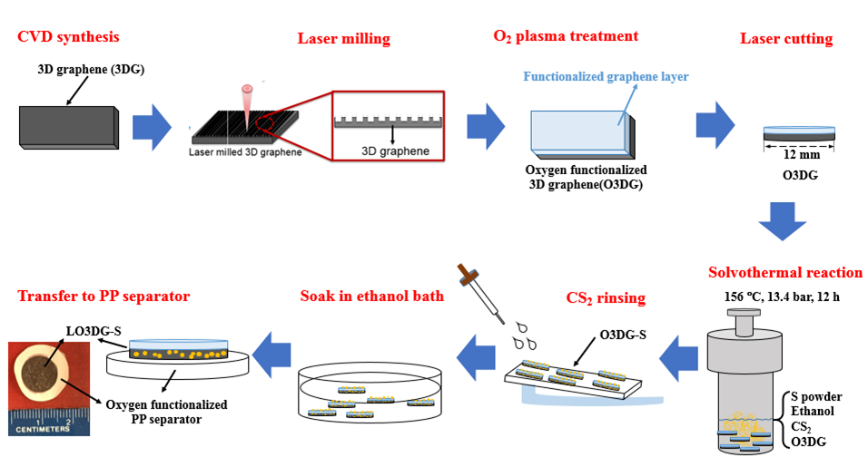
Research Procedures
14
Notes:
CVD Synthesis --

Slide 17
Research Procedures
Laser milling & O₂ plasma functionalized 3D graphene
Laser milling:
The surface area of 3D graphene ↑ accessibility to react with ionic electrolyte ↑
15

Slide 18
Research Procedures
Laser milling & O₂ plasma functionalized 3D graphene
Plasma Treatment (100W, He: 30 L, O₂: 0.2 L, 30s)
The -OH & = O functional groups surface wettability ↑
(inducing hydrophilic surface)
16
Notes:
Plasma -- creates negatively charged OH functional groups repels so that polysulfide don’t sit on cathode surface

Slide 19
Timeline
Research Procedures
WEEK 1 - Introduction to facilities and processes involved WEEK 2 - Training in basic techniques WEEK 3 - Initiation of battery cycling tests WEEK 4 - Refine technique for preparing cathode assemblies WEEK 5 - Use microscopy and spectroscopy to analyze 3D graphene WEEK 6 - Compile all collected data and conduct analysis of results WEEK 7 - Communicate conclusions and next steps for the research
17

Slide 20
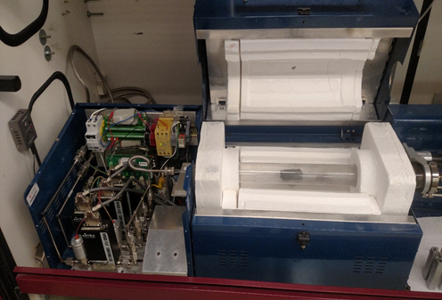
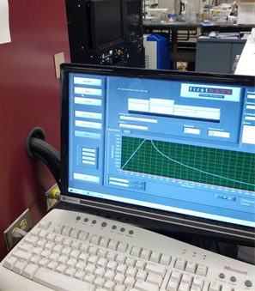
Research Training
Research
Training Received
ET-1000 Reactor
Performs CVD at atmospheric pressure used to synthesize the graphene
18

Slide 21
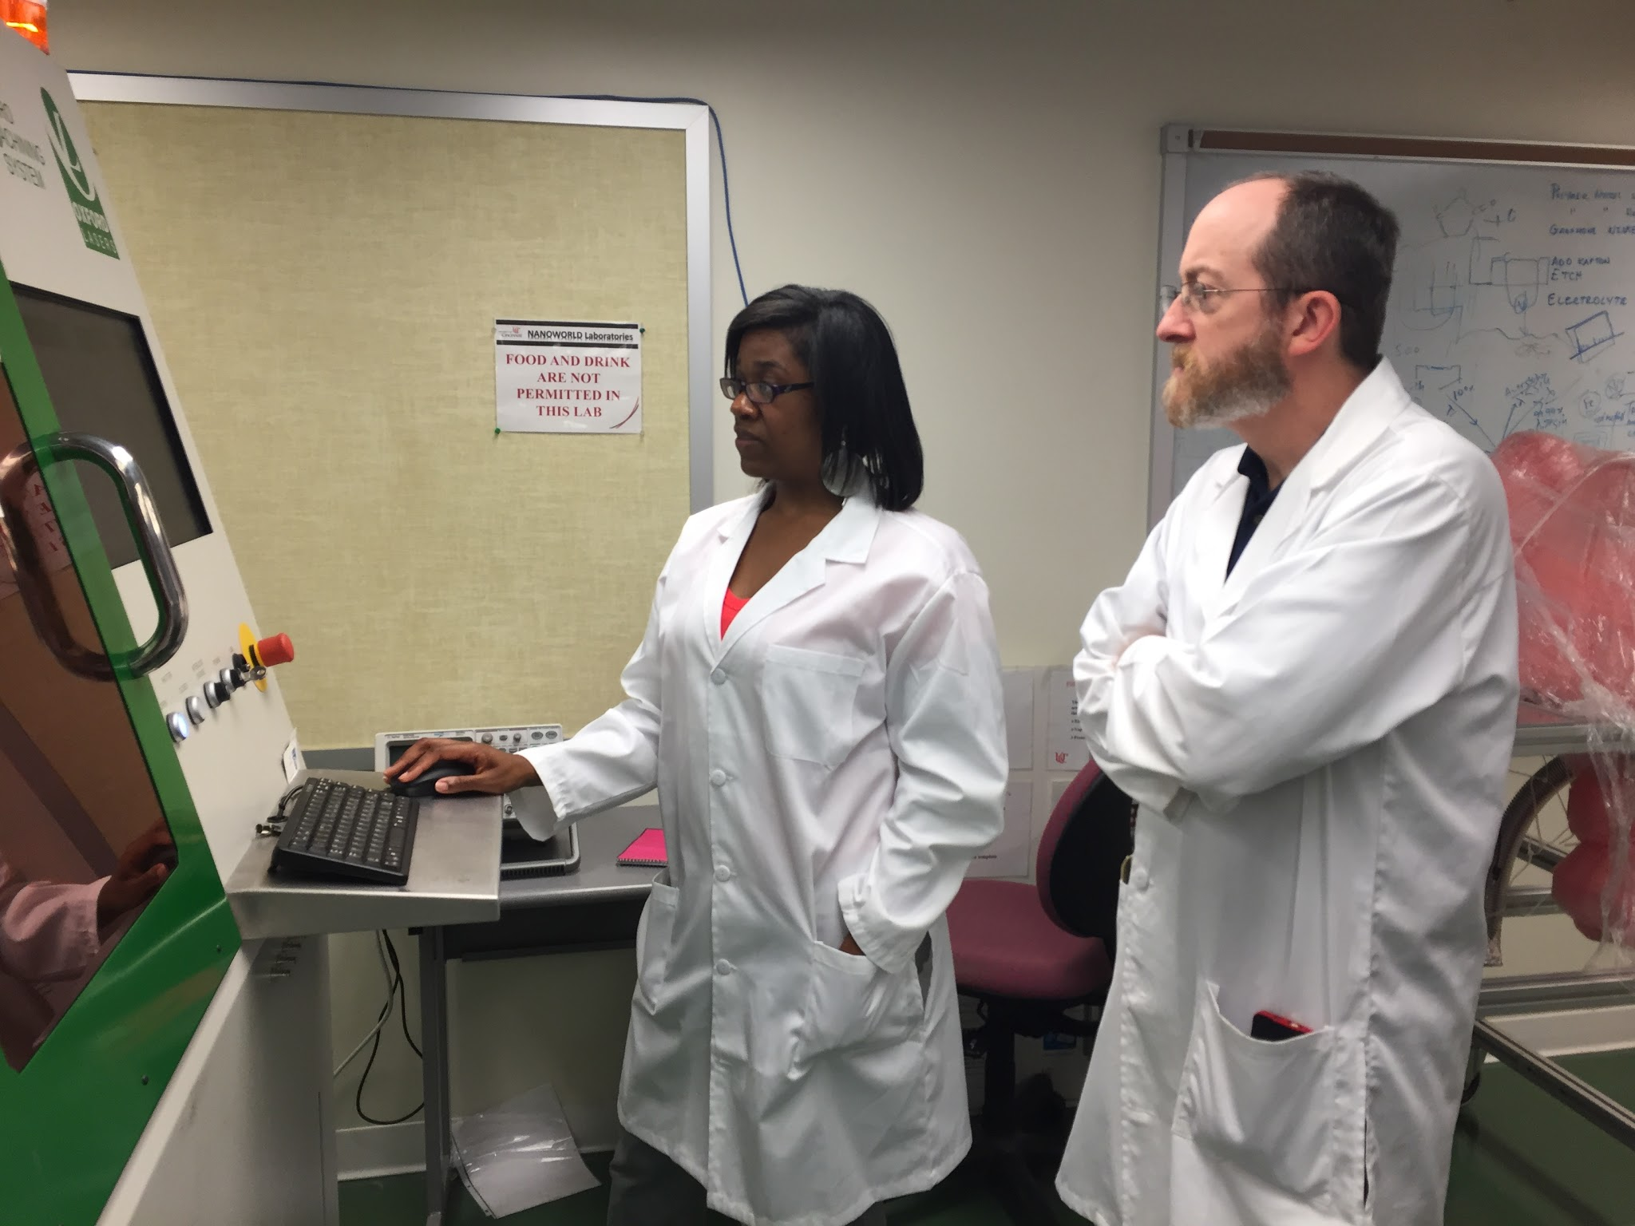
Research Training
Research
Training Received
Laser Mill
Mill the graphene and cut into discs for coin cell battery assembly
Measures the quality of graphene
19

Slide 22
Research
Training Received
Research Training
Raman Spectroscopy (Raman)
Measures the quality of graphene
20
Notes:
RAMAN-- morphology, how thick, defects
SEM -- Scanning Electron Microscopy
TGA -- Thermo
Laser Cutter

Slide 23
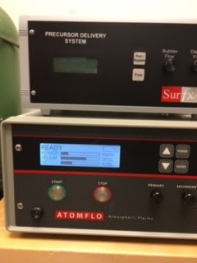
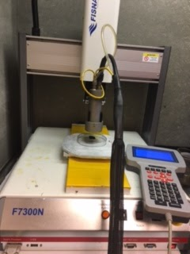
Research Training Received
Research Training
b
c
a
Atmospheric Pressure Plasma Machine
Helium and O₂ b) adjust power, helium & O₂ c) “spraying” sample
21
Notes:
Helium -- “carrier gas”
Ratio: 30 L helium to 0.2 Oxygen to prevent explosion
Source of hydrogen is on the graphene surface (moisture)
In fume hood -- NO O3

Slide 24
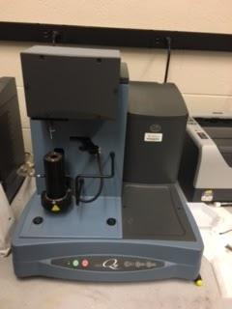
Research
Training Received
Research Training
Thermogravimetric Analysis (TGA)
Determine the %wt of sulfur in sample
22
Notes:
RAMAN-- morphology, how thick, defects
SEM -- Scanning Electron Microscopy
TGA -- Thermo
Laser Cutter

Slide 25
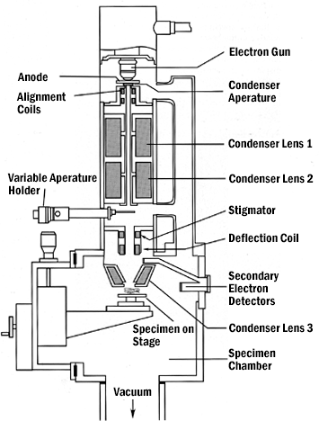
Research
Training Received
Research Training
Scanning Electron Microscopy (SEM)
surface morphology of the composite
23
University of Iowa (2017). “Scanning Electron Microscopy.” Central Microscopy Research Center, https://cmrf.research.uiowa.edu/scanning-electron-microscopy [accessed June 27, 2017].

Slide 26
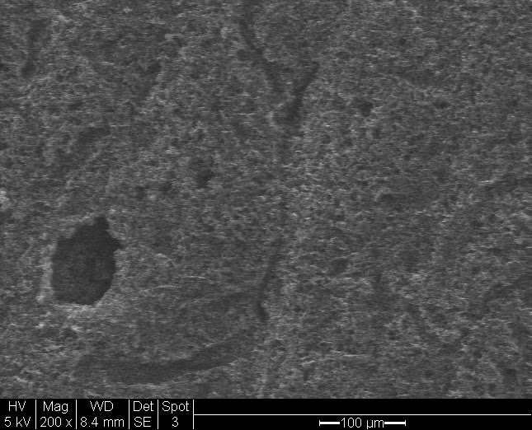
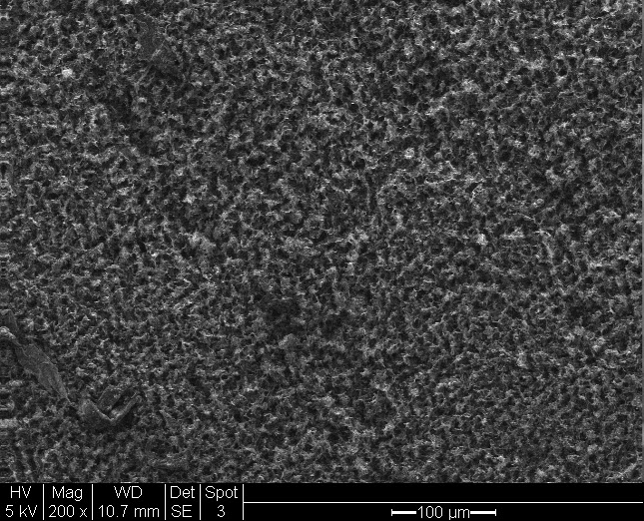
Research Conclusions
Before/After Laser Milling
Pristine Graphene
Laser Milled Graphene
24
Notes:
Weaker mechanical properties than graphene
Less capable of trapping sulfur in cathode during discharge
Sample sent to see if it is on the surface using 2D Raman
Map the entire surface vs using 5 points on surface

Slide 27
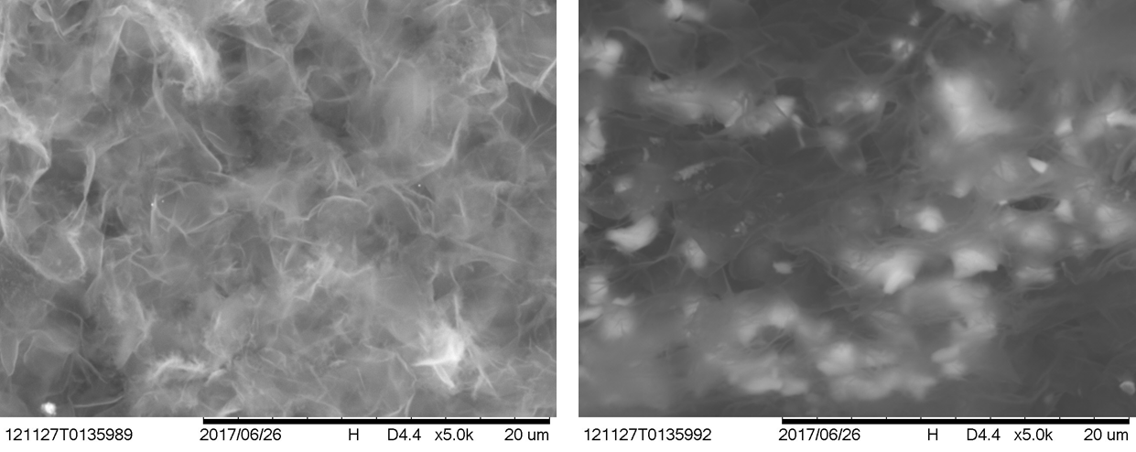
Before Sulfurization
After Sulfurization
Research Results
SEM Image - Effect on morphology after sulfurization (lower magnification)
25

Slide 28
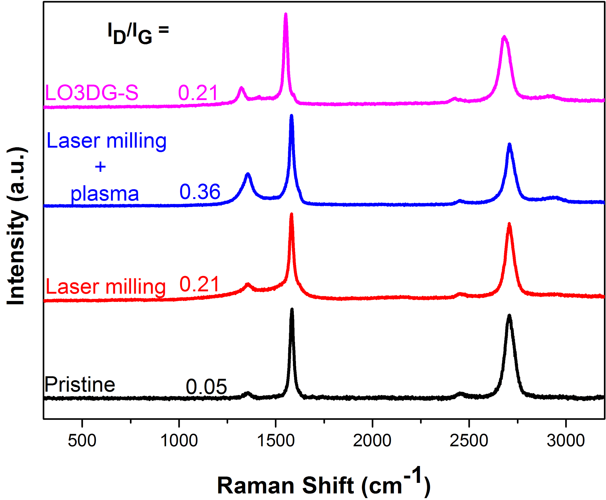
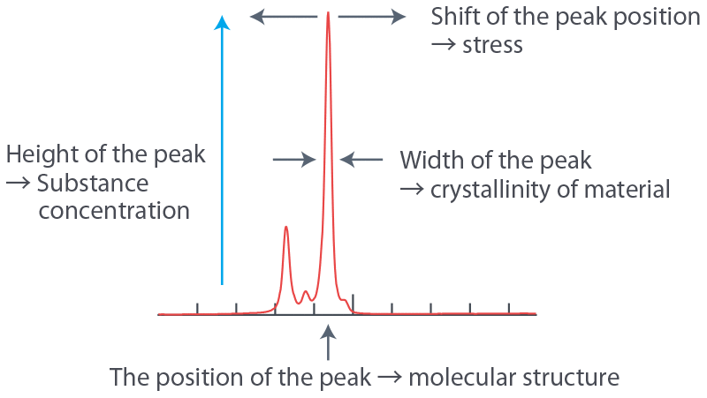
RAMAN - surface of graphene
Research Results
G
2D
D
26
Nanophoton (2016). “What is Raman Spectroscopy?” Available from: http://www.nanophoton.net/raman/raman-spectroscopy.html [accessed Jun 25, 2017].

Slide 29
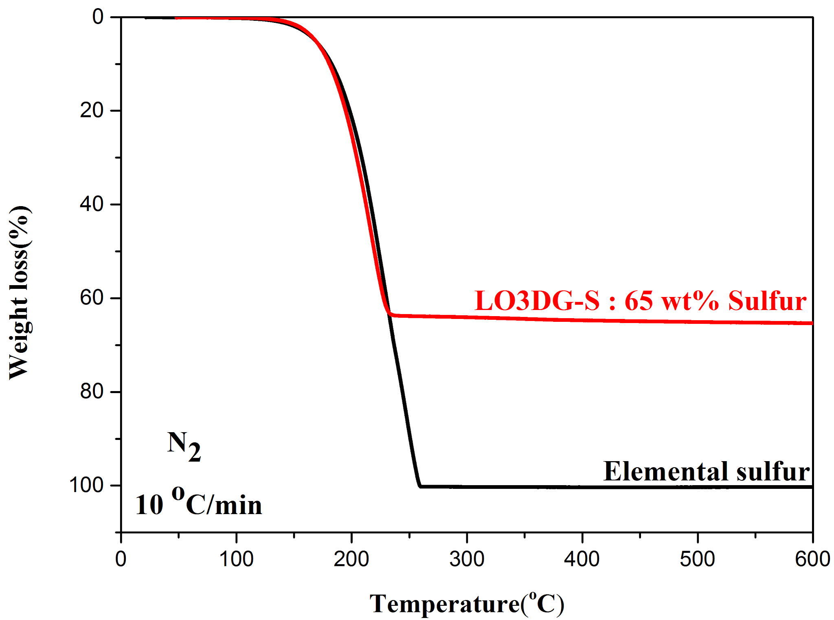
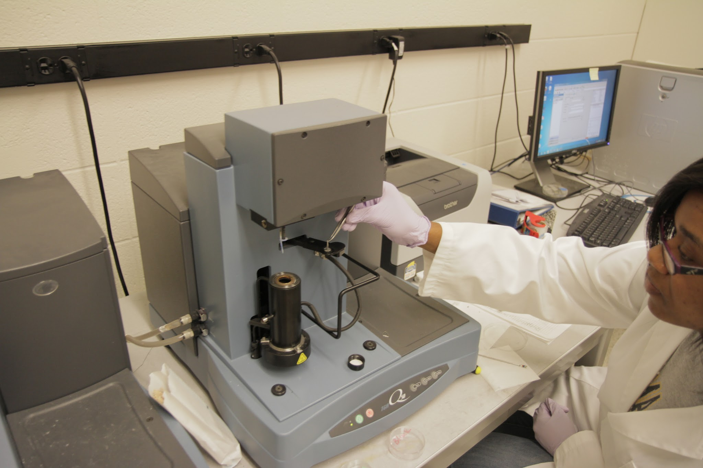
Research Results
Thermogravimetric
Analysis
%wt of sulfur in sample
27
Notes:
TGA Increase temperature and balance weight
Yellow curve -- elemental sulfur
Blue curve-- most recent sample (65 %wt sulfur)

Slide 30
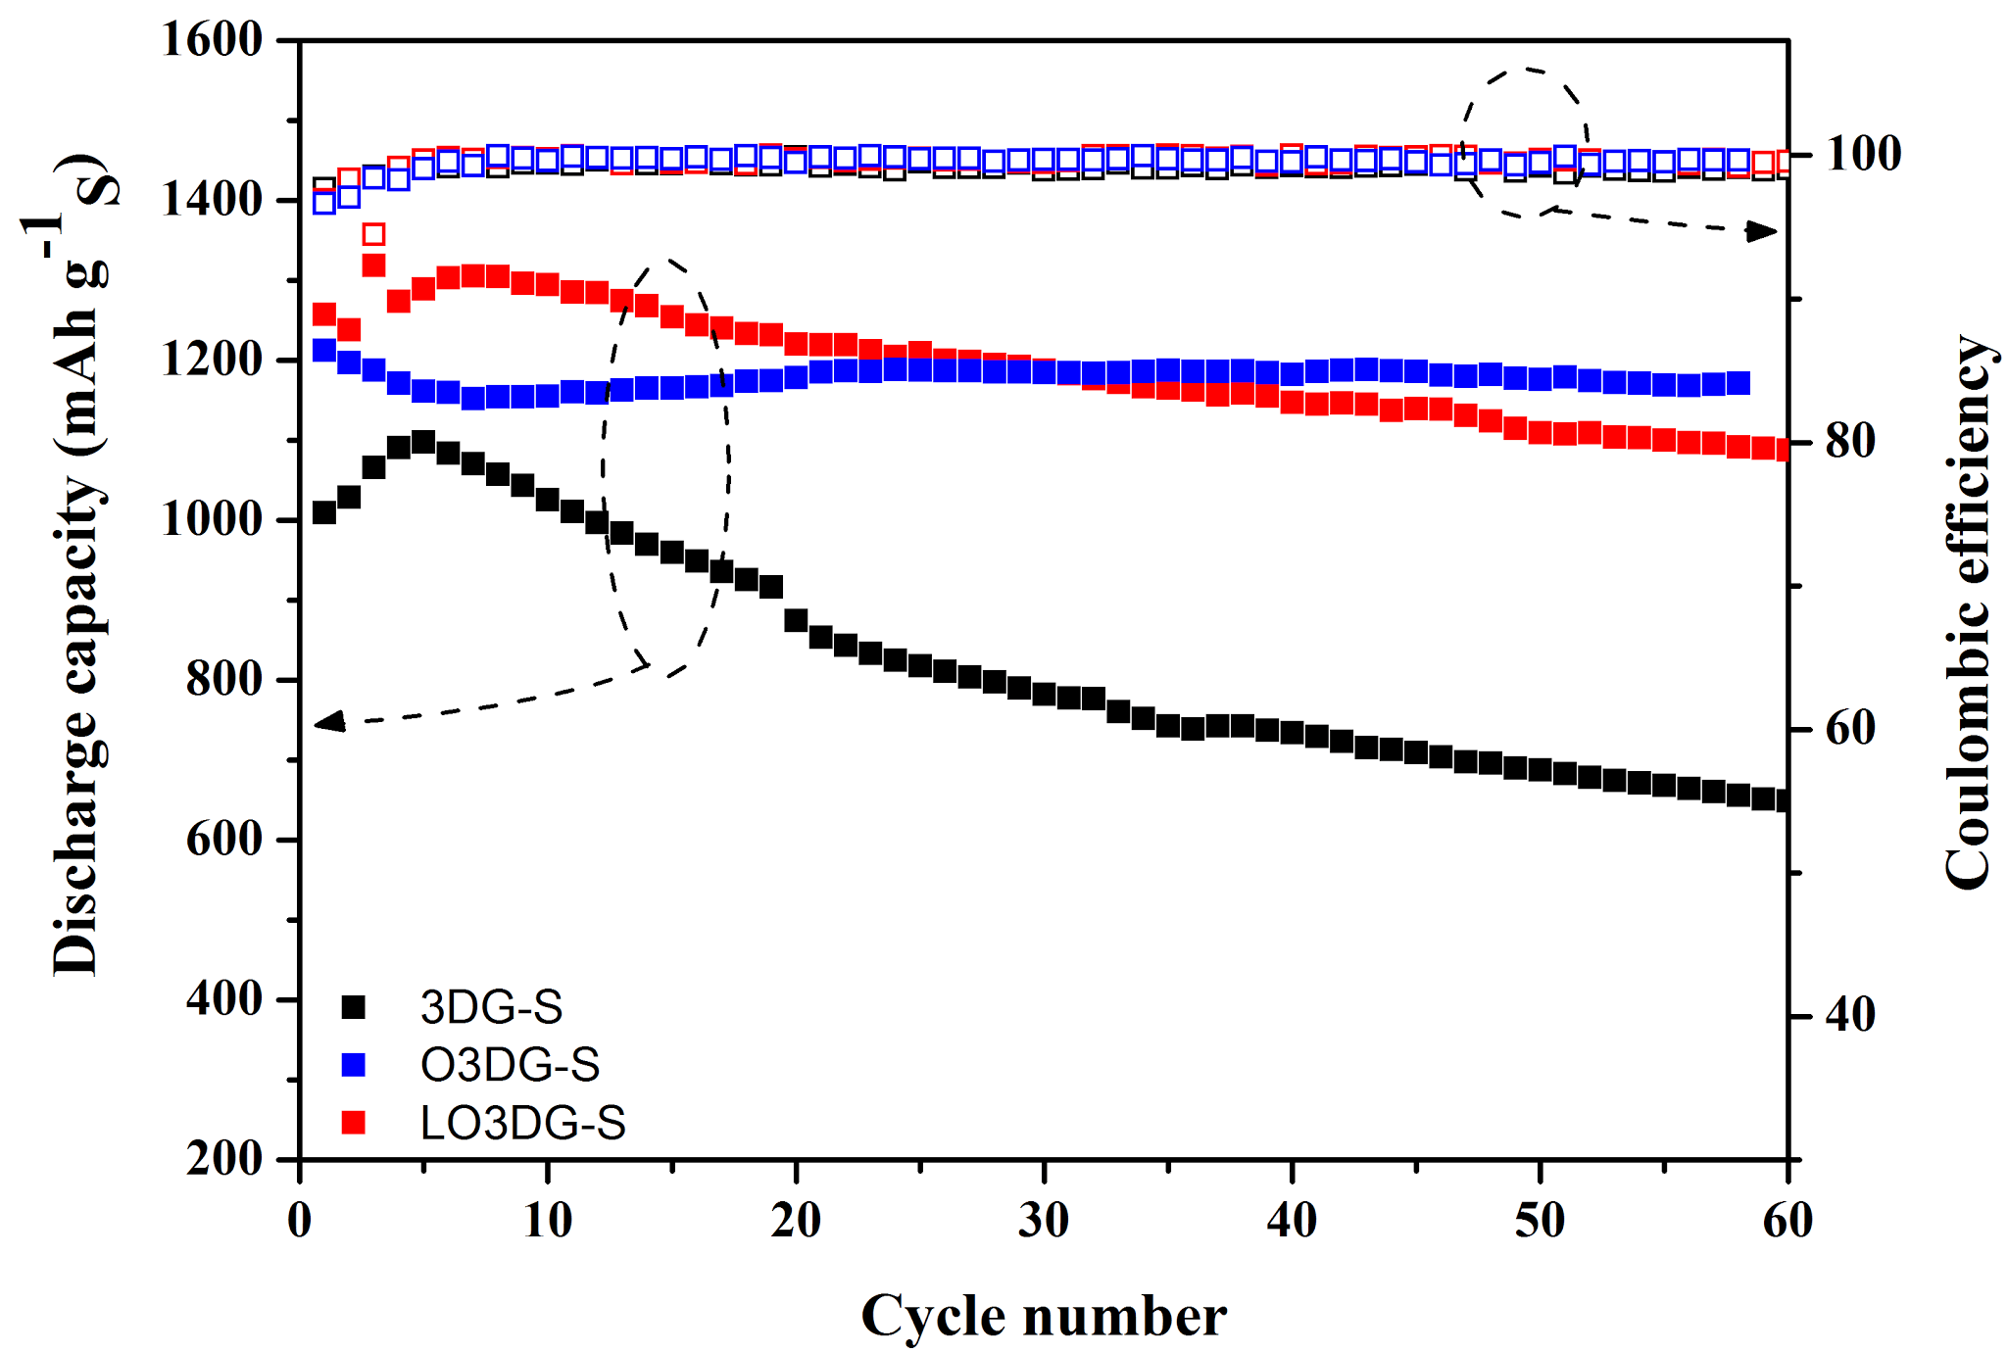
Research Conclusions
28
Notes:
TGA Increase temperature and balance weight
Yellow curve -- elemental sulfur
Blue curve-- most recent sample (65 %wt sulfur)

Slide 31
Research Conclusions
Amorphous carbon
29
Zhang, W., Zhang, Q., Zhao, M.-Q., and Kuhn, L. T. (2013). “Direct writing on graphene ‘paper’ by manipulating electrons as ‘invisible ink’.” Nanotechnology, 24(27), 275301.
Notes:
Weaker mechanical properties than graphene
Less capable of trapping sulfur in cathode during discharge
Sample sent to see if it is on the surface using 2D Raman
Map the entire surface vs using 5 points on surface

Slide 32
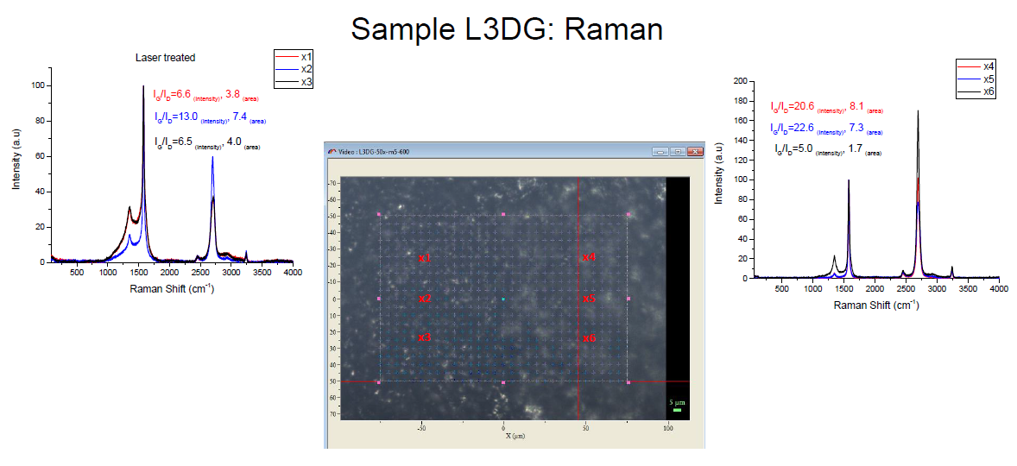
Research Conclusions
Before/After Laser Milling
30
Notes:
Weaker mechanical properties than graphene
Less capable of trapping sulfur in cathode during discharge
Sample sent to see if it is on the surface using 2D Raman
Map the entire surface vs using 5 points on surface

Slide 33
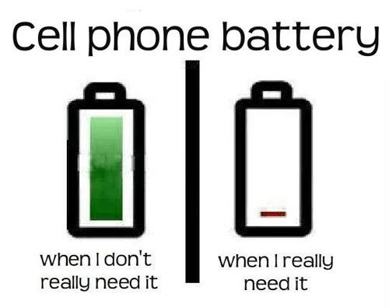
Unit Plans
Big Idea: ELECTRICAL ENERGY CONSERVATION
Essential Question:
How can we use math to conserve electrical energy to reduce the use of fossil fuel?
Challenge:
Use mathematical evidence to develop three strategies for the student population to use to conserve phone battery life
https://tr.pinterest.com/explore/cell-phone-humor/
TIARA ANDERSON
31
BATTERY BLUES
Purcell Marian High School Math Department

Slide 34
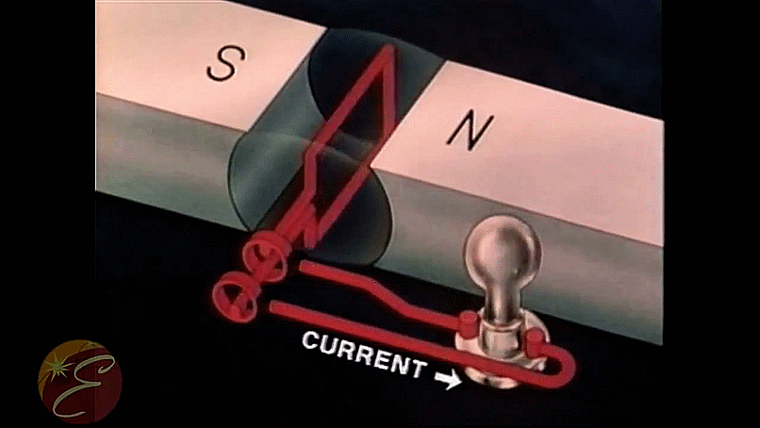
Ready Access to Energy
Unit Plans
How does a generator work?
(What are the parts of a generator?)
How can we recharge a battery when power outlets are not available?
What is the relationship between magnetic fields and current flow?
What is the relationship between electron flow, electron potential, and resistance to flow?
MICHAEL SULLIVAN
32
DESIGN & BUILD AN ELECTRIC GENERATOR
Princeton High School STEM Program

Slide 35
Questions?
33
Grant ID No.: EC-1404766

